Slide 1
BIG DATA GROUP 10
Non-federal acute care hospital health IT adoption and use ANALYSIS Muma College of Business, Dept. Of Information Systems and Management ISM 6562 – Dr. Kaushik Dutta TEAM: Chelsea Anestal, DEEPTHI Martina Bhaskar, Francisco Jacques, and Madhuri Kankanala

Slide 2


Data Source
Healthcare IT Adoption in Non-Federal Acute Care Hospitals:
Data Source: The U.S. Department of Health & Human Services (ONC for Health Information Technology) from Data.gov.
Dataset: “Non-federal acute care hospital health IT adoption and use” located on https://catalog.data.gov/dataset/non-federal-acute-care-hospital-health-it-adoption-and-use.
Description: Tracks electronic health record (EHR) adoption, patient health information exchange, and patient engagement capabilities in hospitals. The data will be used to assess variations in IT adoption across different healthcare facilities.

Slide 3

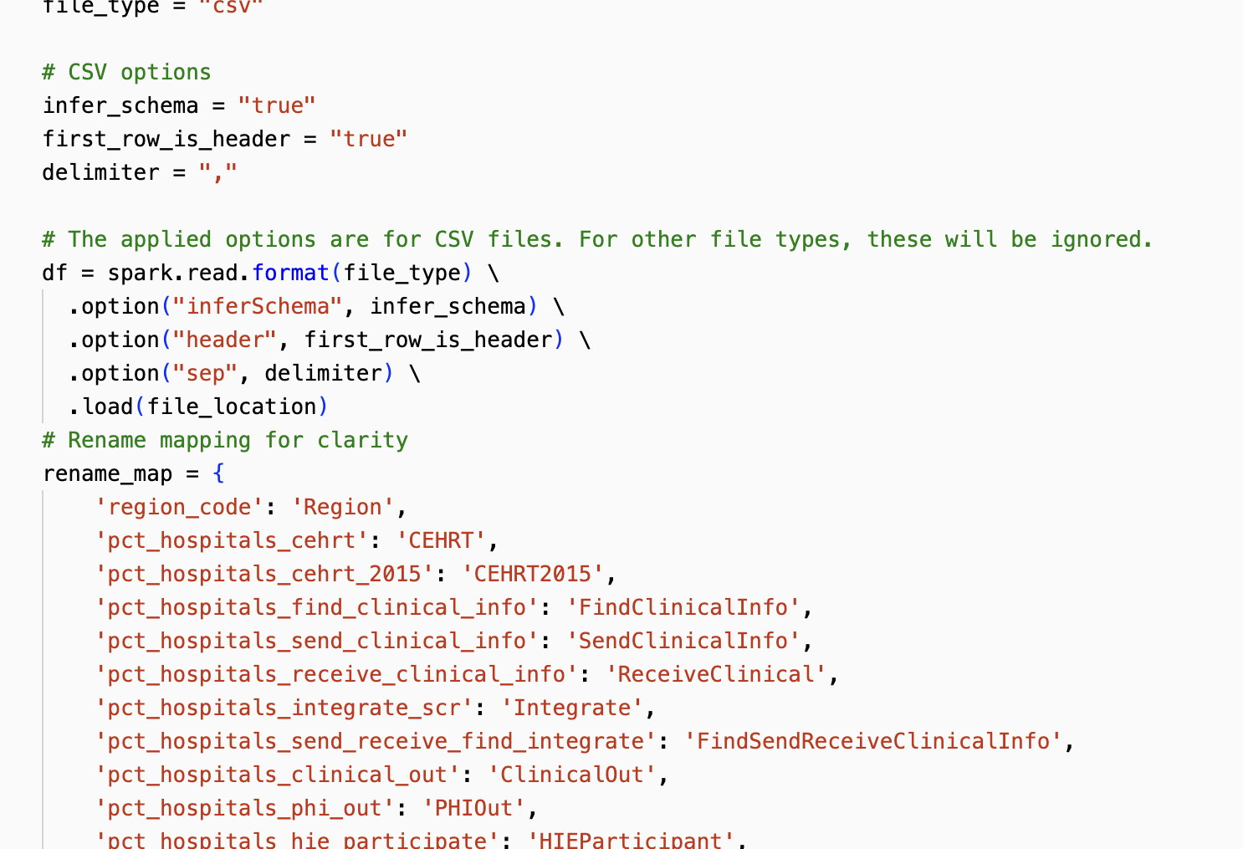
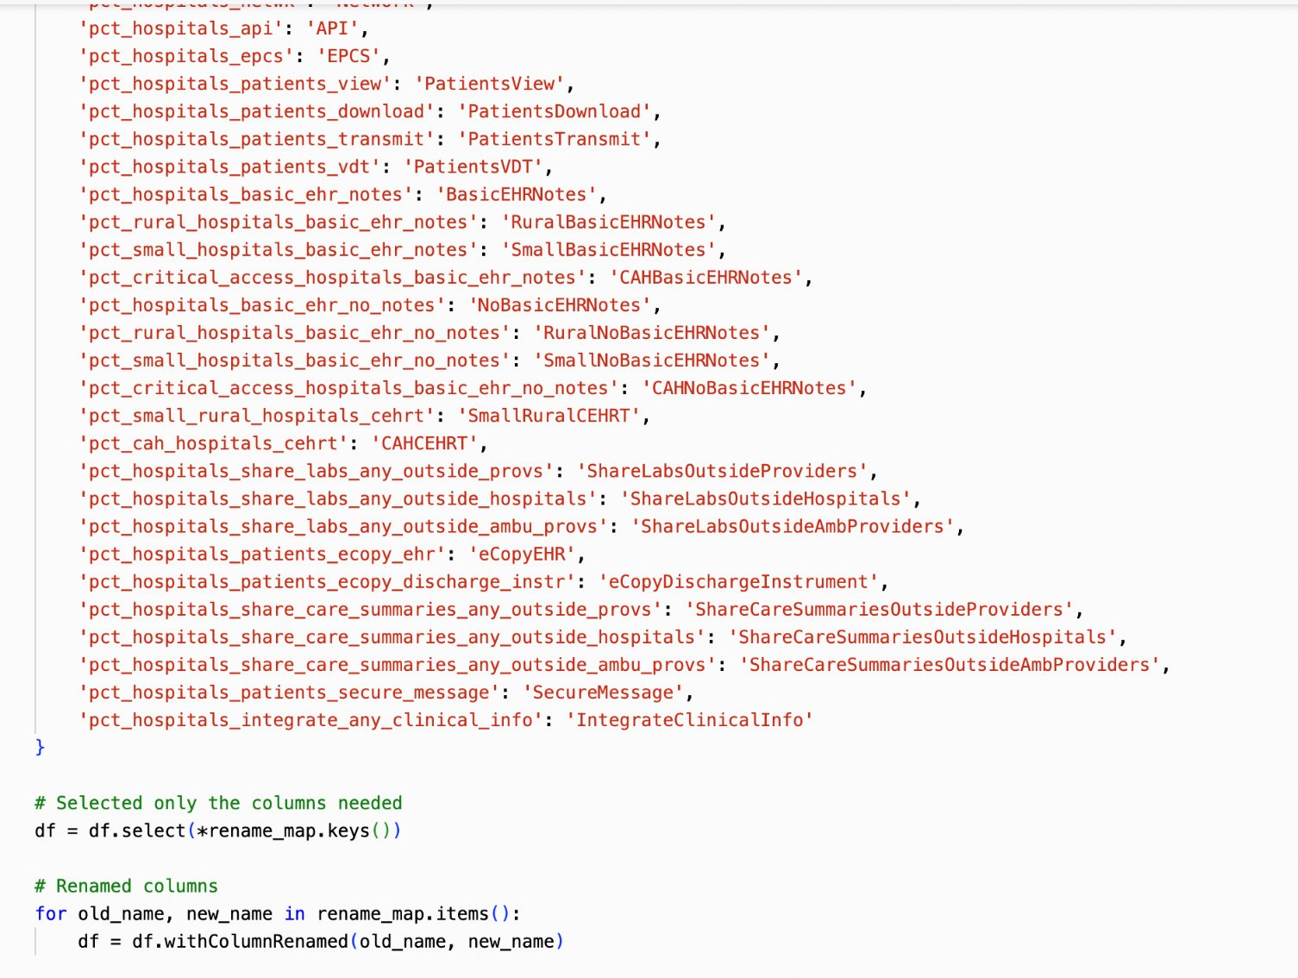
Data Cleaning Process
Imported data set
Renamed columns
Removed columns that will not be used for machine learning

Slide 4
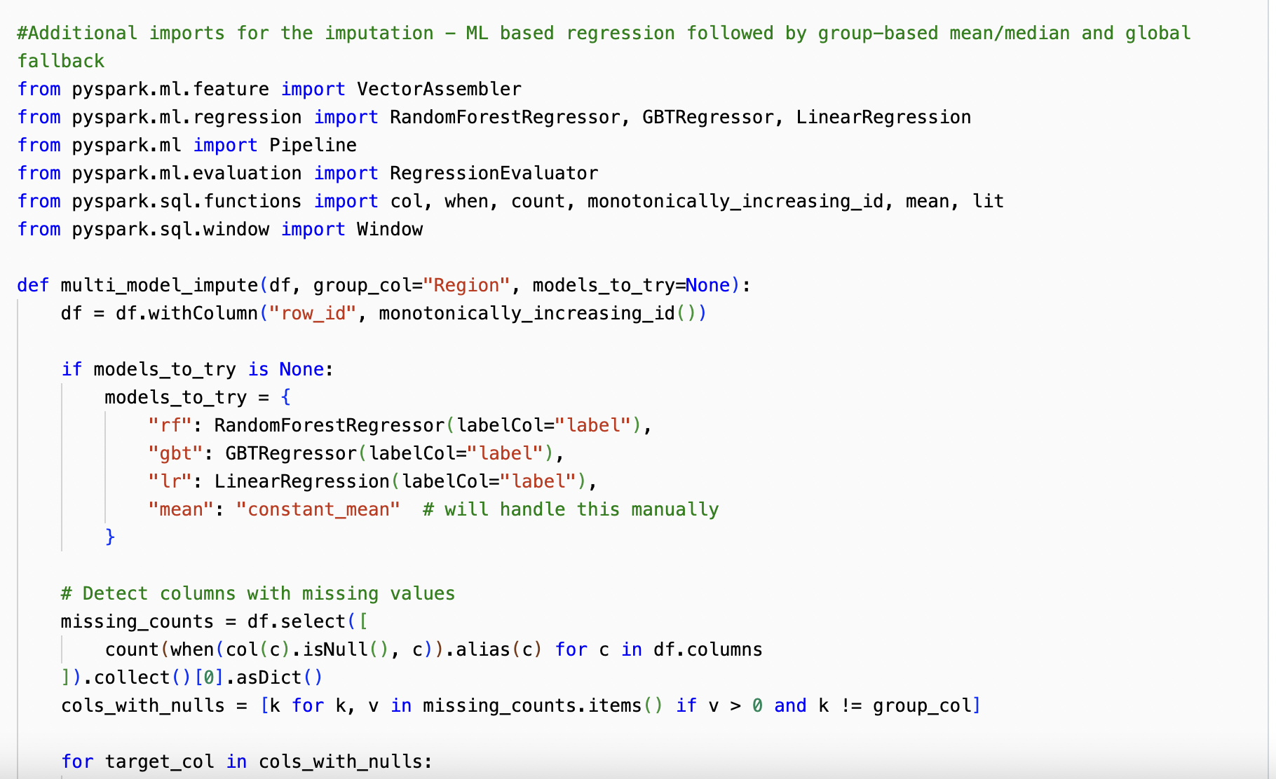
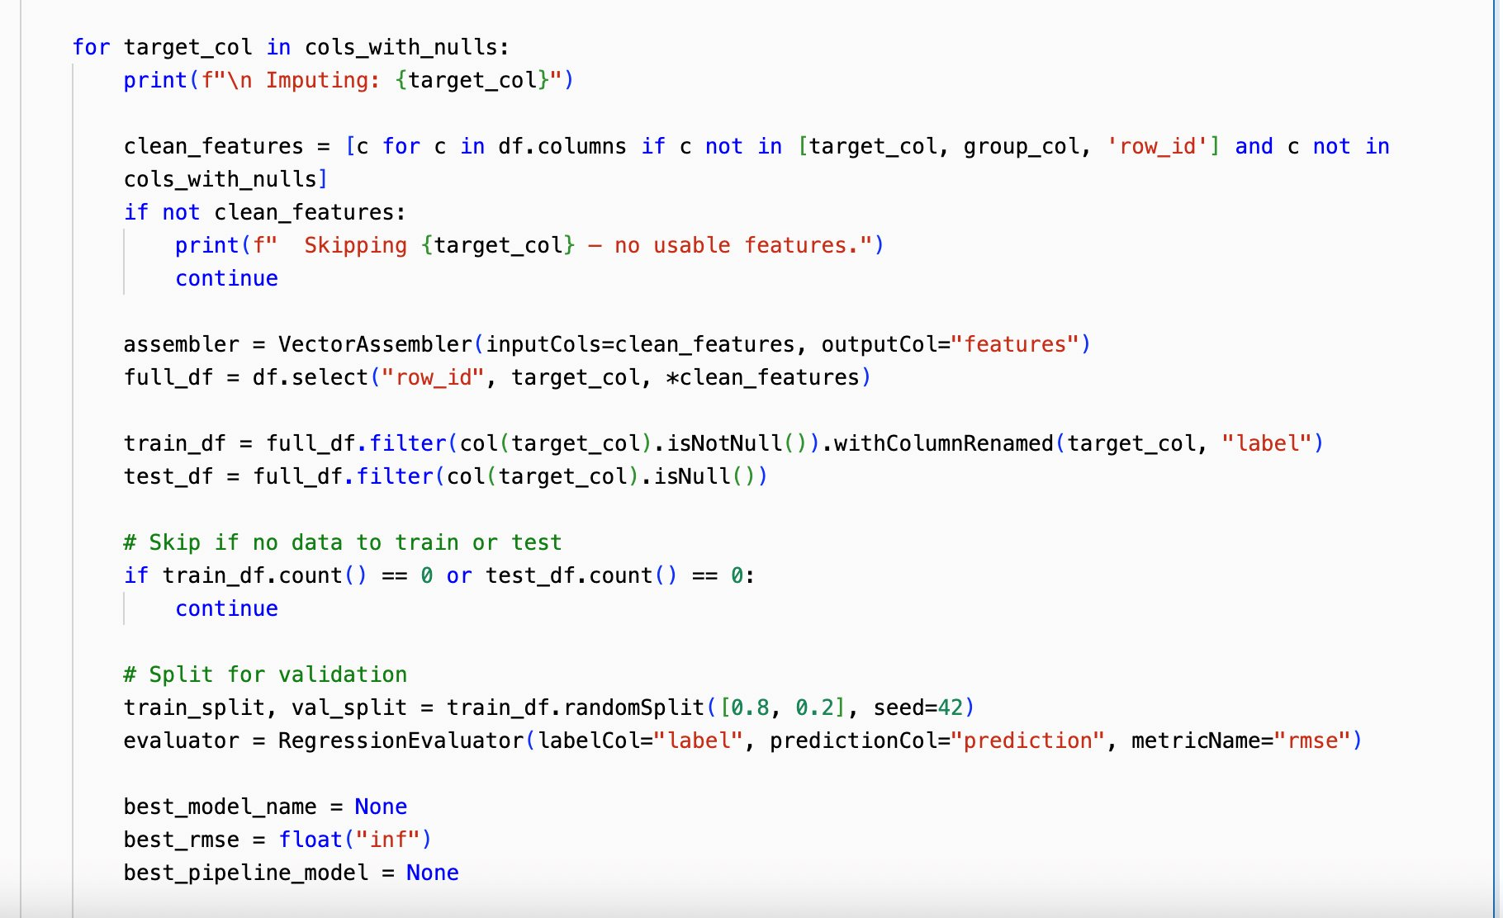
Data Cleaning Process
Removed columns that will not be used for machine learning
Imputed null values with multi-ML Model per feature and group-based mean

Slide 5
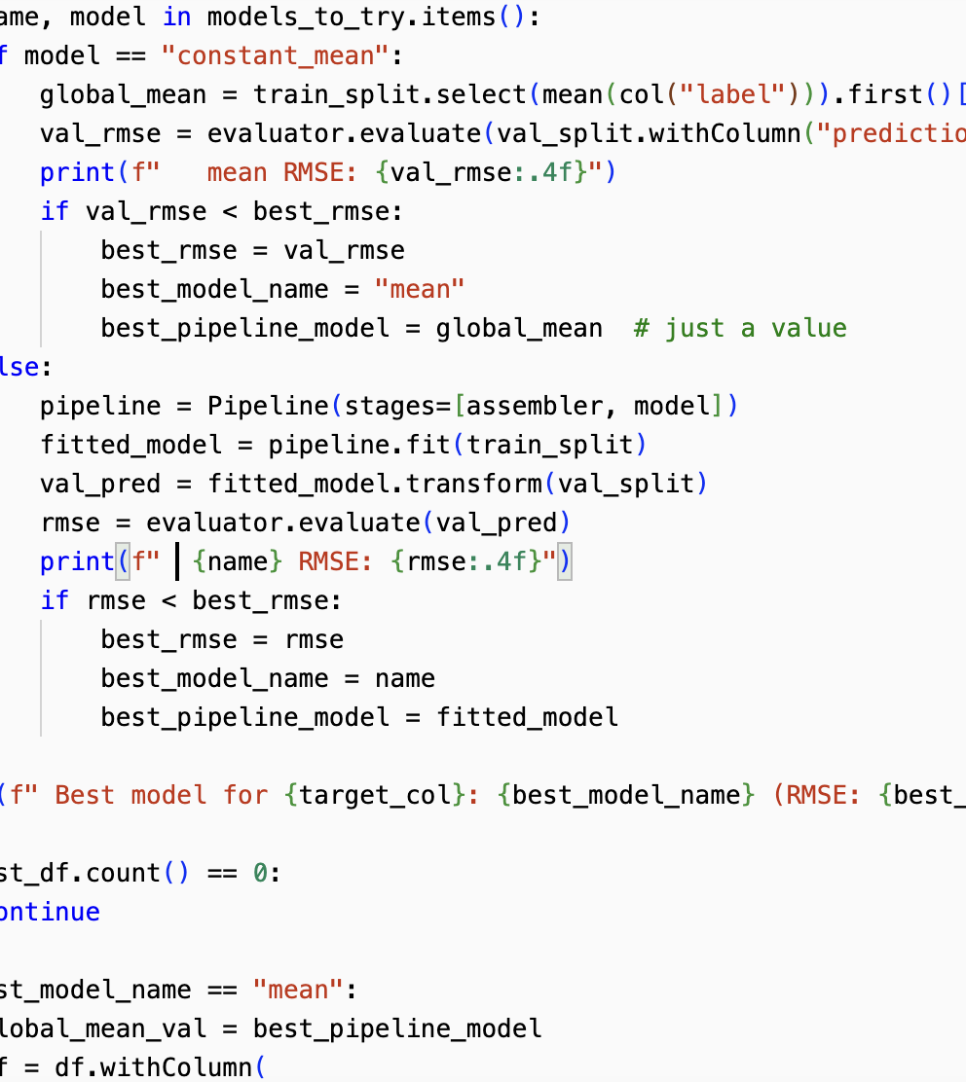
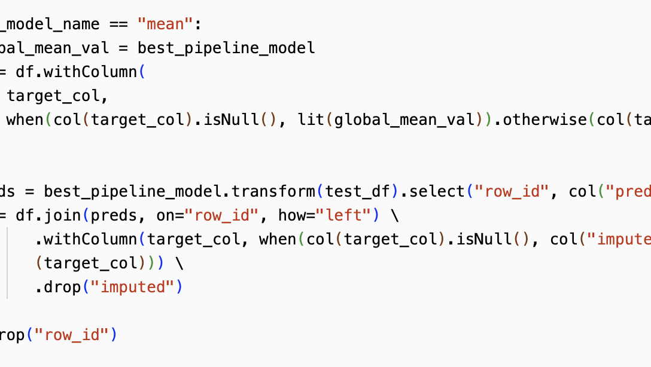
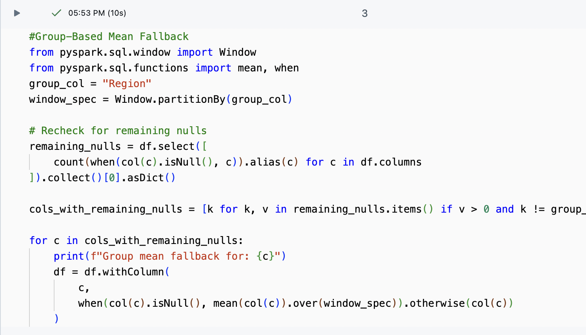
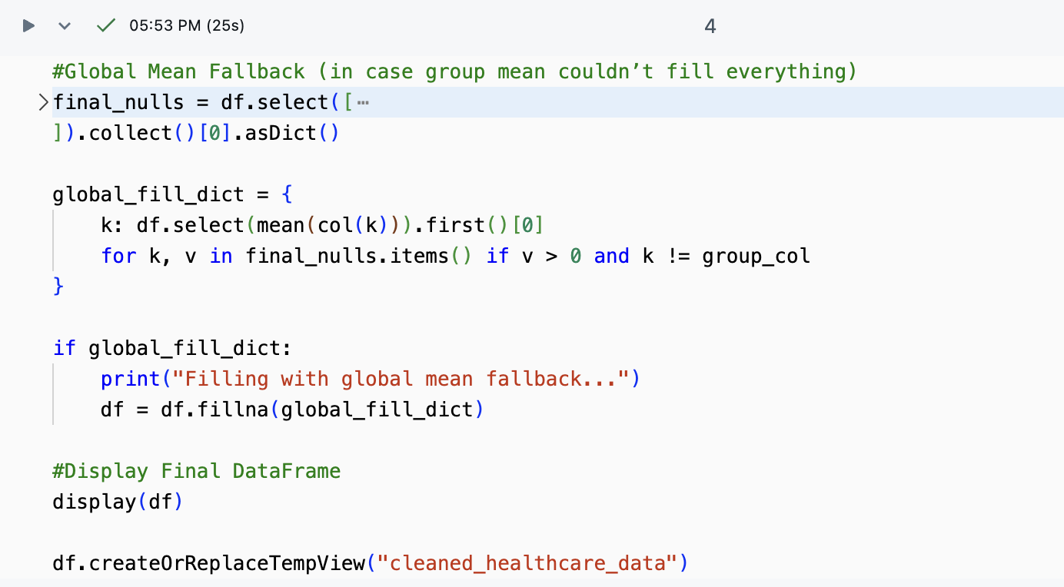
Data Cleaning Process
Removed columns that will not be used for machine learning
Imputed null values with multi-ML Model per feature, group-based mean, and global mean fallback

Slide 6
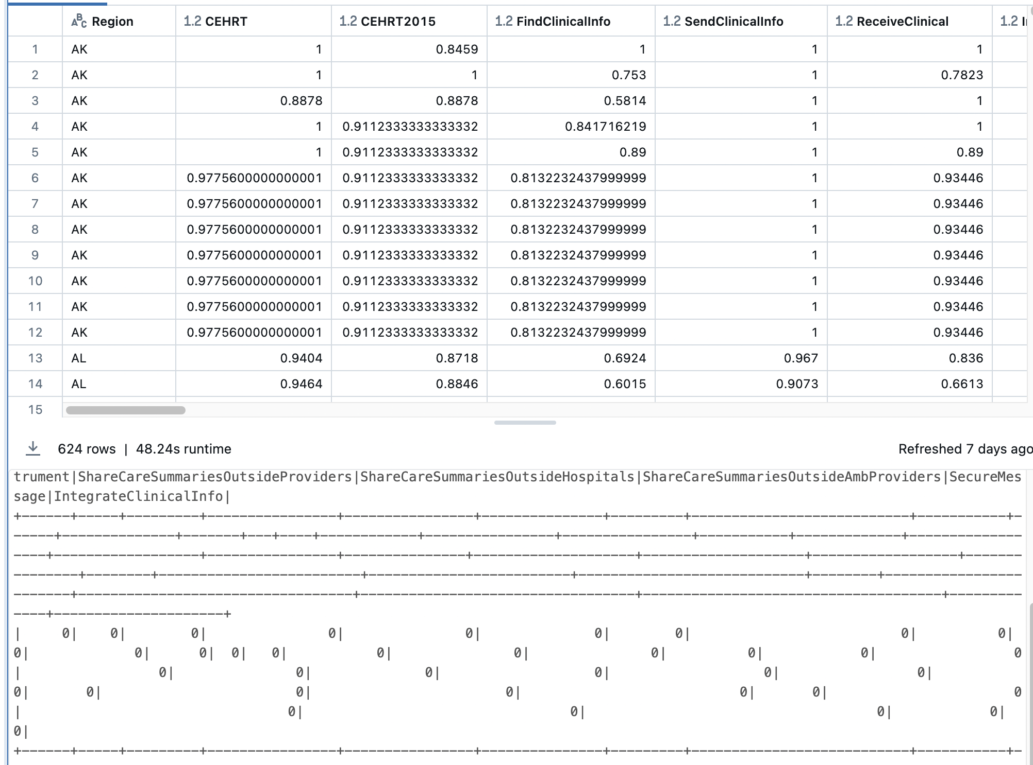
Data Cleaning Process
Displayed the updated dataset
Verify all nulls are accounted for

Slide 7
Data Cleaning Challenges and Solutions
Dealing with large amounts of missing data, especially from rural hospitals
Solution: multi-model machine learning imputation system that tested three regressors — Random Forest, Gradient Boosted Trees, and Linear Regression — and automatically selected the best one using RMSE scores.
Avoiding unrealistic imputed values that could distort the data
Solution: evaluated each model on a validation split, and if none performed well, I used a fallback based on the constant mean of that feature
Ensuring no missing data remained across all hospitals and features
Solution: two-layer fallback: first applying group-based mean imputation by region, and then using a global mean as a final safety net

Slide 8
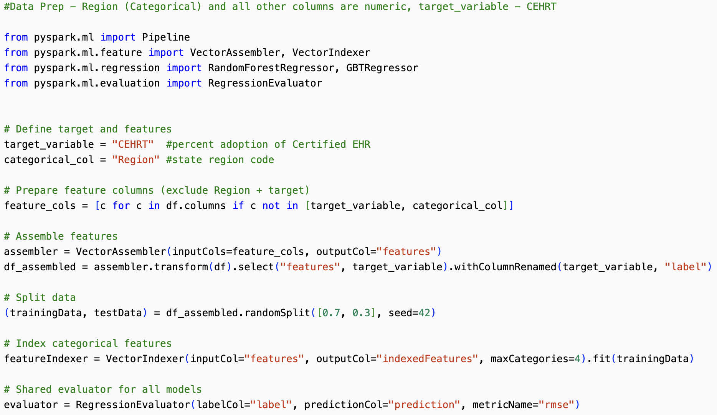
MACHINE LEARNING DATA PREP
Completed necessary imports
Separated the categorical and target variable
Defined target and features
Assembled features
Train/Test Split
Indexed categorical features
Share evaluator

Slide 9
analyzing hospital EHR adoption rates using advanced SQL queries
Goal: Identify regional leaders/laggards in EHR adoption and understand growth drivers.

Slide 10
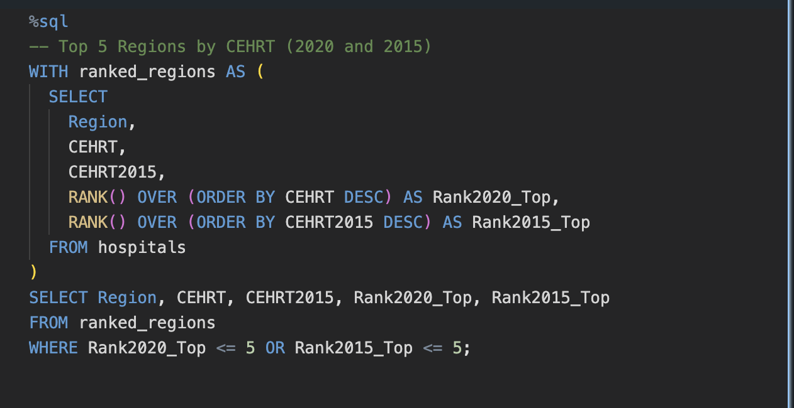
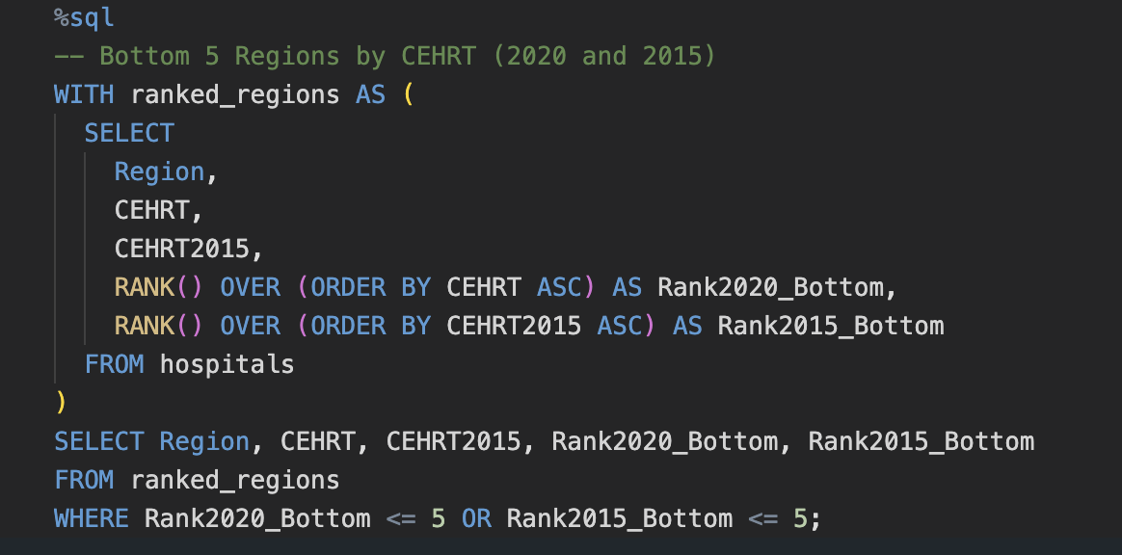
Code - Ranking
Window Functions in Action Rank regions by 2015/2020 adoption rates

Slide 11
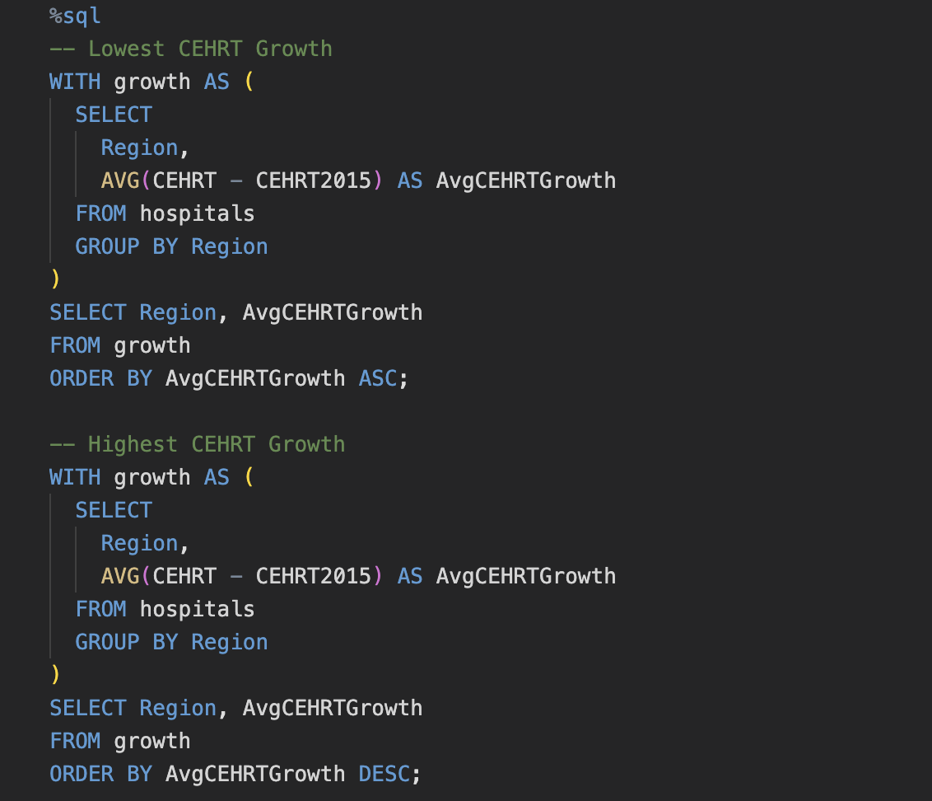
Code – Growth ANALYSIS
Common Table Expression (CTEs ) for Clean Analysis Calculate adoption growth rates

Slide 12
Code – Growth ANALYSIS
Common Table Expression (CTEs ) for Clean Analysis Calculate adoption growth rates

Slide 13
Comprehensive Model Evaluation: Visualizing Performance and prediction accuracy
Goal:
To provide clear, comparative visualizations of model performance, error distributions, and prediction accuracy—enabling data-driven selection of the best predictive model.

Slide 14
Key Visualizations OVERVIEW
Model Performance & Error Analysis
RMSE Comparison (Bar Chart)
Code Highlight: Dynamic model/RMSE extraction with color-coding
Residual Distribution (Box Plot)
Code Highlight: Spark-to-Pandas conversion for Seaborn compatibility
Prediction Accuracy (Interactive Plot)
Code Highlight: Plotly for zoom/hover functionality

Slide 15
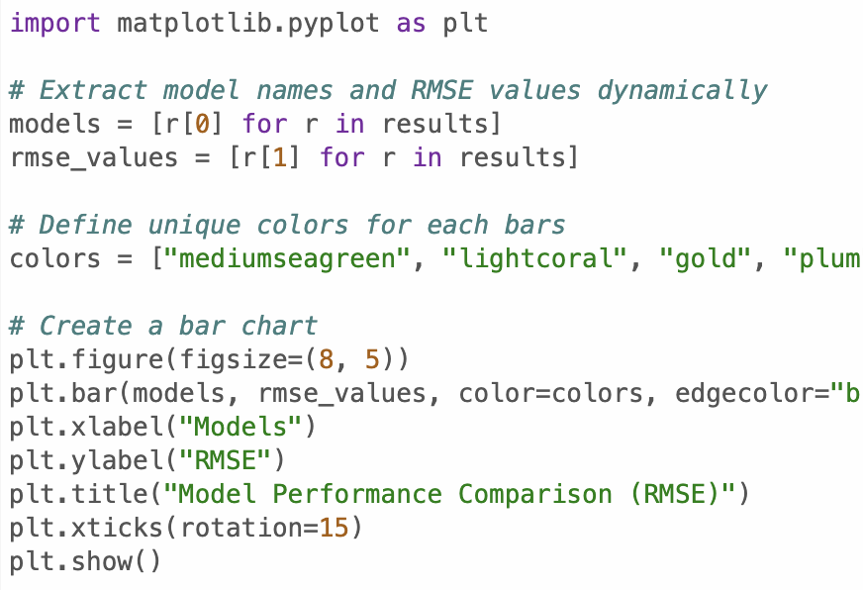
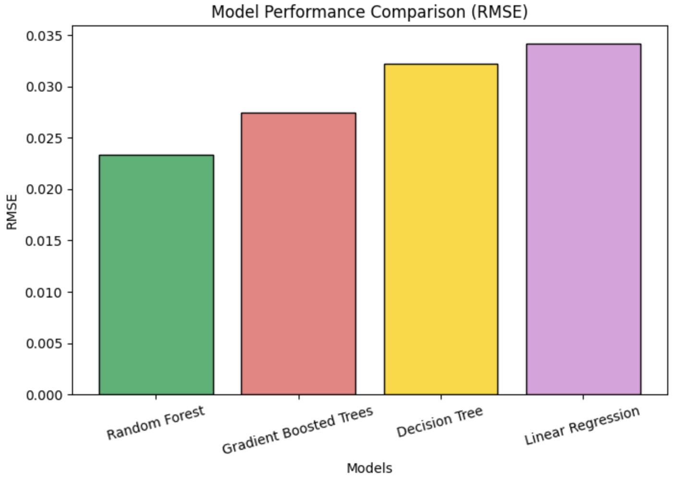
RMSE Comparison (Bar Chart)
Dynamic Extraction: Pulls model names/RMSE values directly from results
Visual Clarity: Color-coding highlights top performers (green = best)
Use Case: Quick comparison of prediction accuracy across algorithms

Slide 16
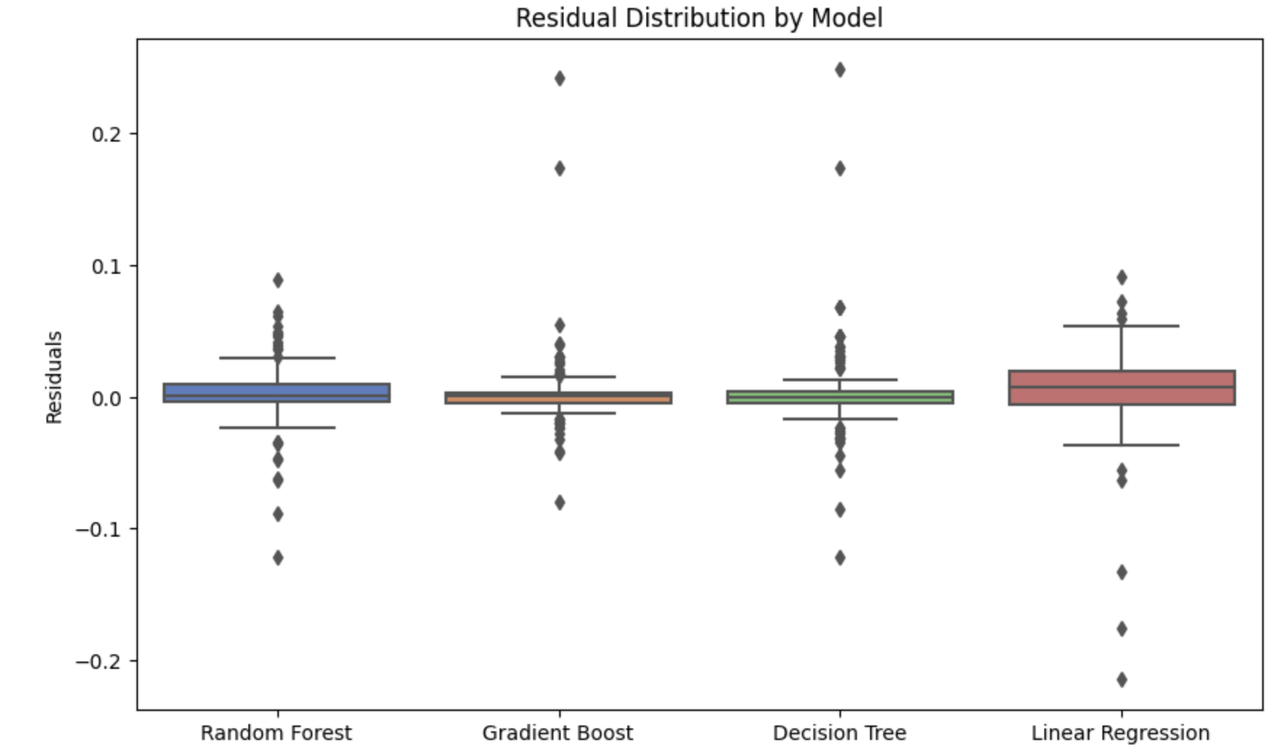
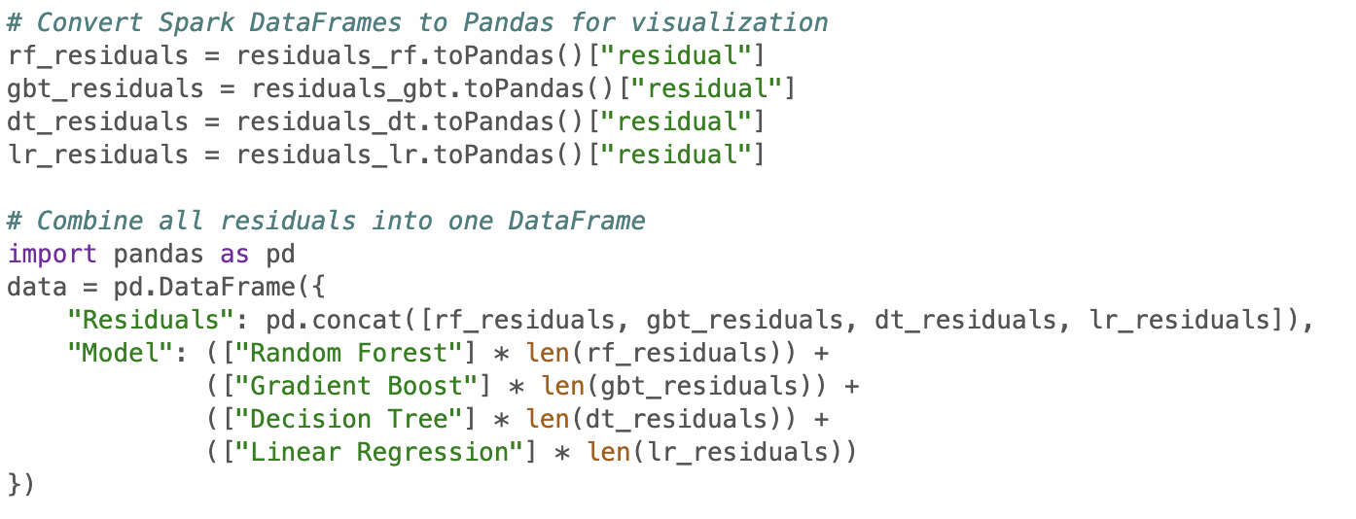
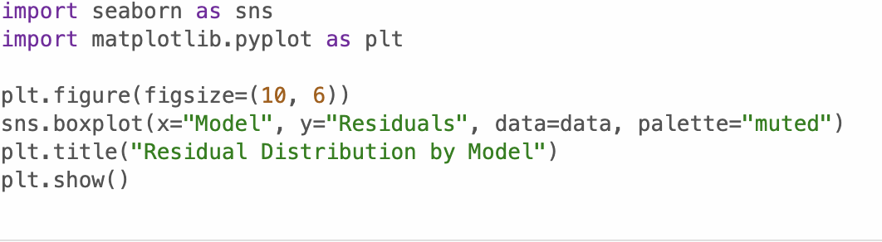
Prediction Error Analysis (Box Plot)
Data Pipeline: Converts Spark residuals → Pandas → Seaborn visualization

Slide 17
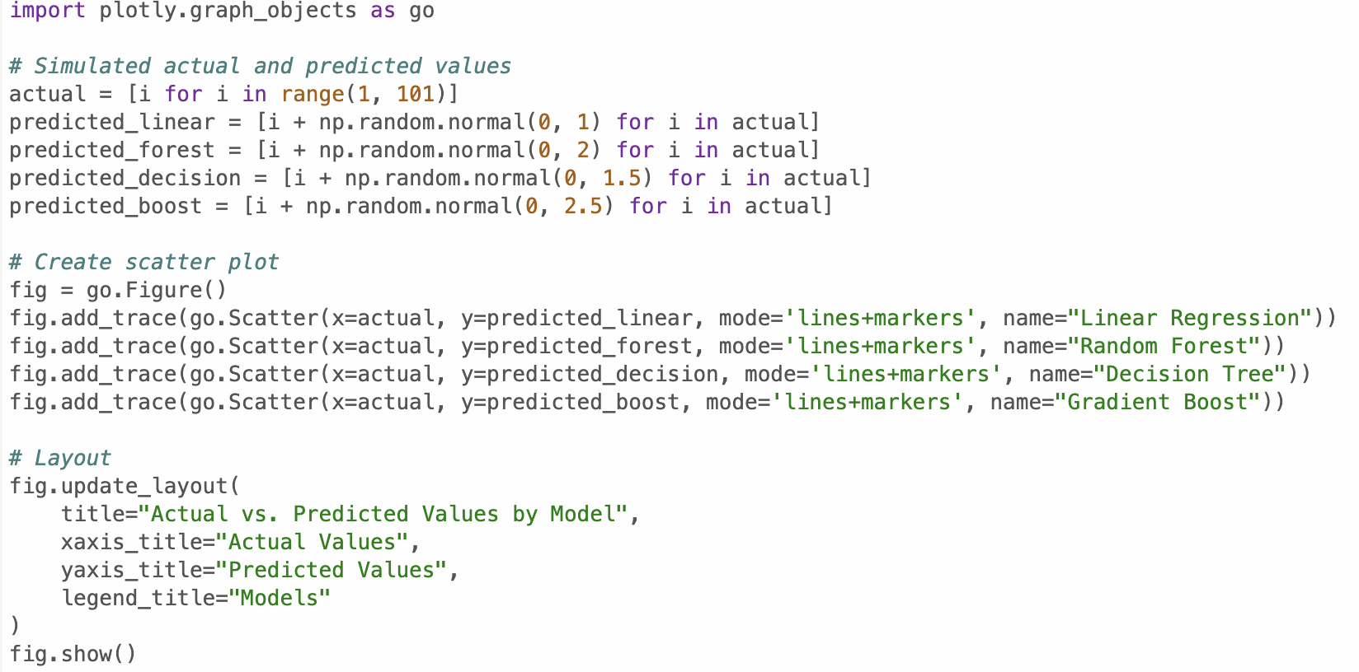
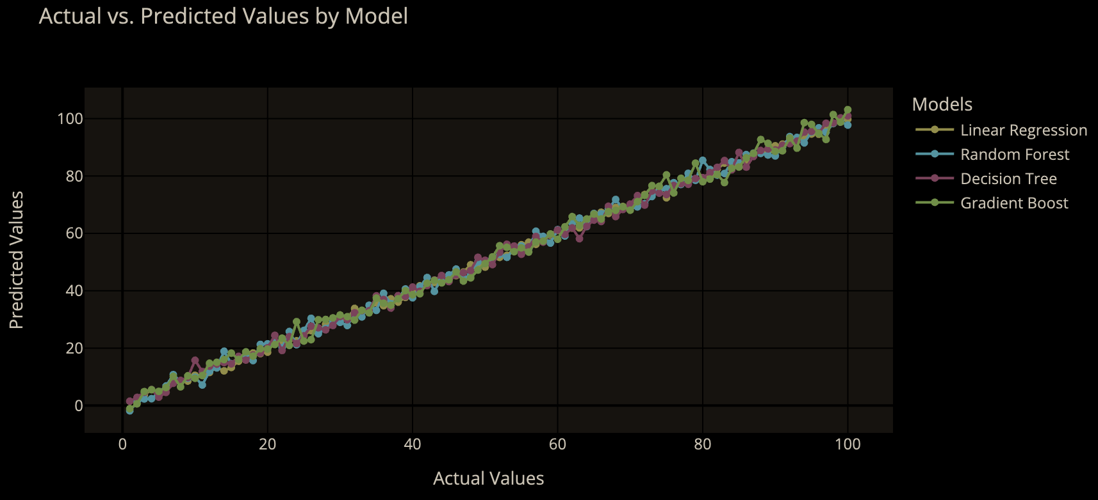
Actual vs Predicted Values (Interactive Plot)
Model Comparison: Parallel lines show systematic over/under-prediction

Slide 18
Code Structure & Documentation
Use version control to manage multiple code versions.
Keep visualization code separate from data processing.
Organize code into well-labeled cells with clear headings and comments.
Challenges:
Merge conflicts across different code versions, troubleshooting and decoding errors to keep the notebook running smoothly end-to-end.

